Slide 1

Ehsan Saeedi - 97723272
Spring-2019
Notes:
Kafka® is used for
building real-time data pipelines
and streaming apps.
It is
horizontally scalable,
fault-tolerant,
wicked fast,
and runs in production in thousands of companies.
LinkedIn, Microsoft and Netflix process four comma messages a day with Kafka (1,000,000,000,000).
Publish/subscribe messaging is a pattern that is characterized by the sender (publisher) of a piece of data
(message) not specifically directing it to a receiver. Pub/sub systems often have a broker, a central point where messages are
published, to facilitate this.

Slide 3
Notes:
Apache Kafka is a publish/subscribe messaging system designed to solve this problem.
It is often described as a “distributed commit log” or more recently as a “distributing
streaming platform.”

Slide 4
Agenda
History
Introduction
Use Cases
Kafka Internal
Kafka Streams
Summary

Slide 5
History
Kafka’s Origin
LinkedIn’s Problem
The Birth of Kafka The development team at LinkedIn was led by Jay Kreps. primary goals were:
Decouple producers and consumers
Persistent message data
High throughput
Horizontal scalable
Kafka was released as an open source project on GitHub in late 2010
Notes:
address the data pipeline problem at LinkedIn
Designed to provide a high-performance messaging system that can handle many types of data
and provide clean, structured data about user activity and system metrics in real time.
Monitoring and user-activity tracking could not use the same backend service.
The monitoring service was too clunky, the data format was not oriented for activity
tracking, and the polling model for monitoring was not compatible with the push
model for tracking
At the same time, the tracking service was too fragile to use for
metrics, and the batch-oriented processing was not the right model for real-time
monitoring and alerting.
The decision was made to move forward with a custom infrastructure for the data pipeline.
Apache Software Foundation incubator project in July of 2011

Slide 6

I thought that since Kafka was a system optimized for writing, using a writer’s name
would make sense. I had taken a lot of lit classes in college and liked Franz Kafka. Plus
the name sounded cool for an open source project.
So basically there is not much of a relationship.
Jay Kreps

Slide 7
Agenda
History
Introduction
Use Cases
Kafka Internal
Kafka Streams
Summary

Slide 8
Kafka is run as a cluster.
The Kafka cluster stores streams of records in categories called topics.
Each record consists of a key, a value, and a timestamp.

Slide 9
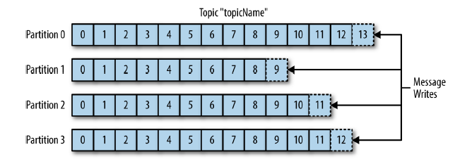
Topics and Partitions
A topic is a category to which records are published.
Multi-subscriber
Can have consumers
Partition is ordered, immutable sequence of records
Notes:
the core abstraction Kafka provides for a stream of records.
The closest analogies for a topic are a database table or a folder in a filesystem.
Each partition is an ordered, immutable sequence of records that is continually appended to
Topics are additionally broken down into a number of partitions.
Note that as a topic typically has multiple partitions, there is no guarantee of message time-ordering across the entire topic, just within a single
partition.
Partitions are also the way that Kafka provides redundancy and scalability. Each partition can be hosted on a different server, which means that a
single topic can be scaled horizontally across multiple servers
Most often, a stream is considered to be a single topic of data, regardless of the number of partitions.
The offset is another bit of metadata—an integer value that continually increases—that Kafka adds to each message as it is produced. Each message in a given
partition has a unique offset.
The Kafka cluster durably persists all published records—whether or not they have been consumed—using a configurable retention period

Slide 10
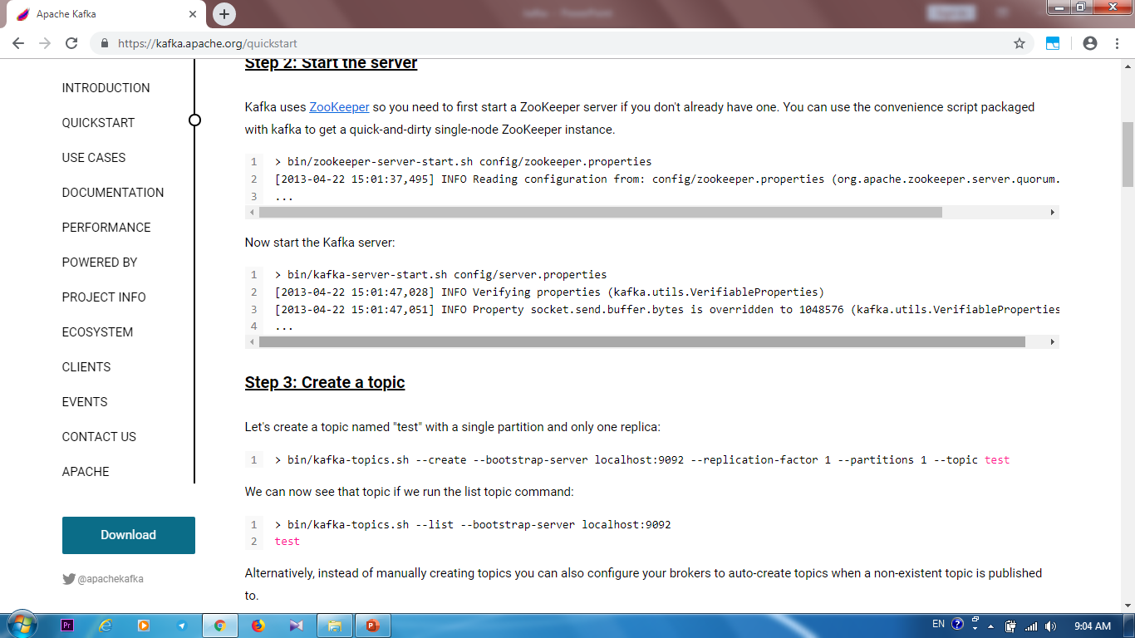
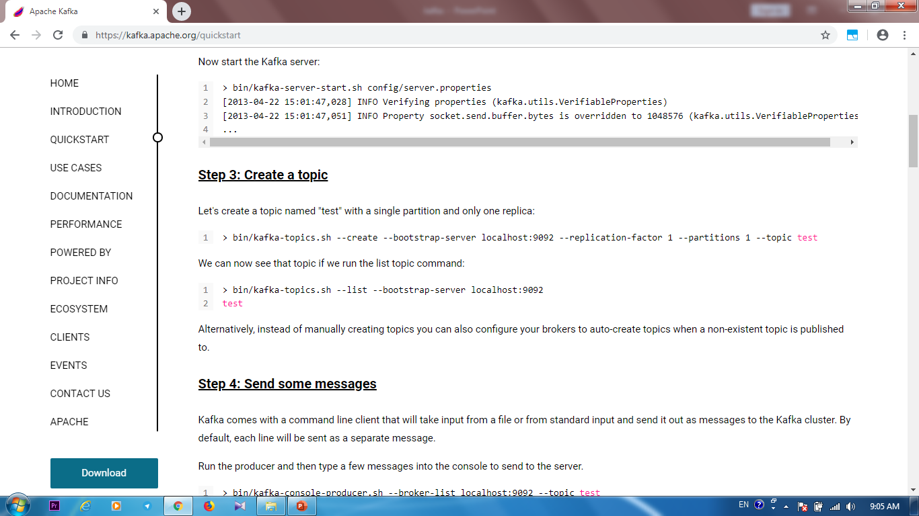

Slide 11
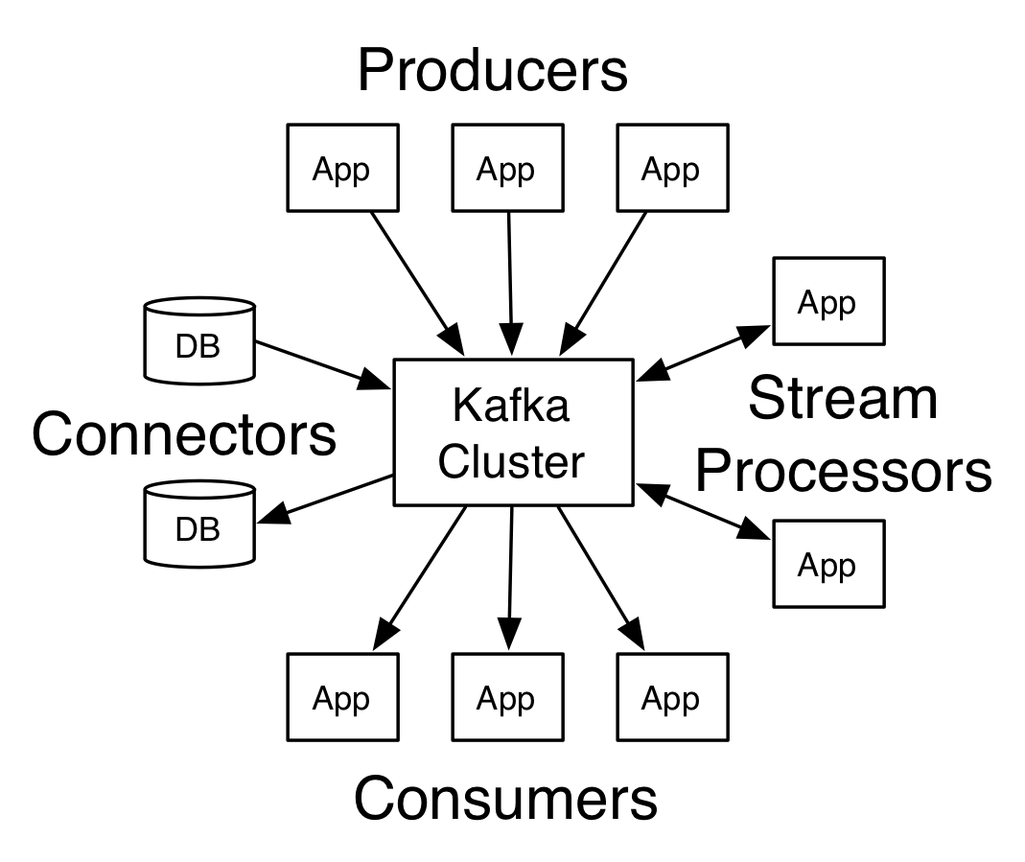
Producers and Consumers
Two basic types of Kafka client.
Producers publish data to the topics.
Consumers read messages.
Notes:
By default, the producer does not care what partition a specific message is written to
and will balance messages over all partitions of a topic evenly. In some cases, the producer
will direct messages to specific partitions.
The consumer keeps track of which messages it has already consumed by keeping track of the offset of messages.
Consumers work as part of a consumer group, which is one or more consumers that work together to consume a topic.

Slide 12
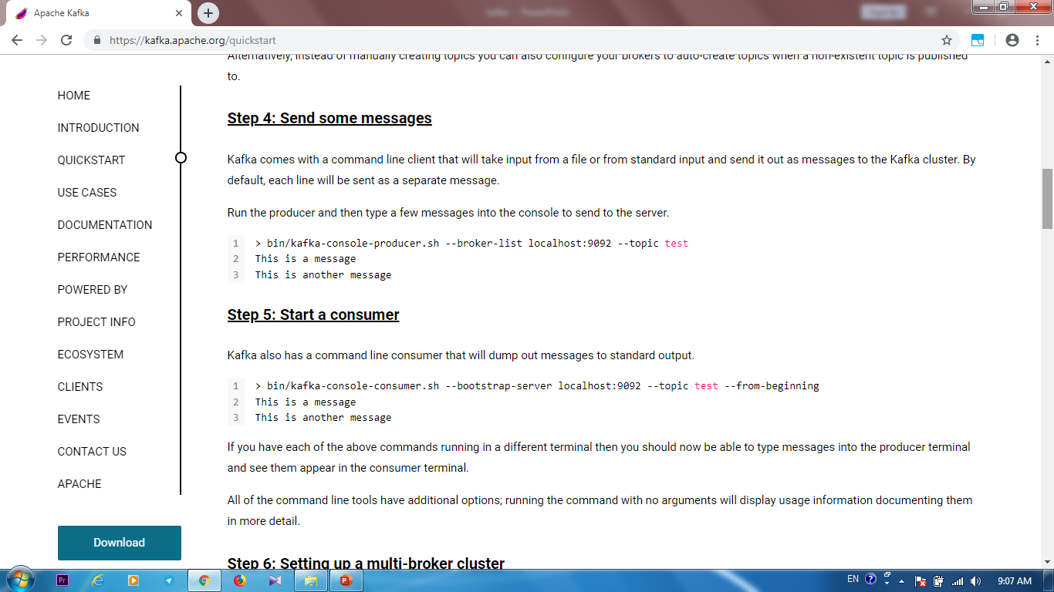

Slide 13
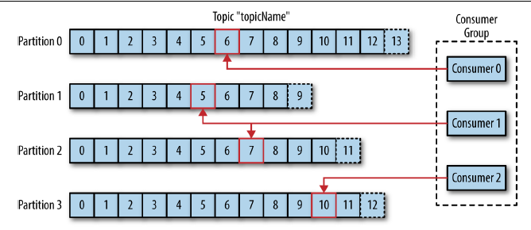
Consumer group
Notes:
The mapping of a consumer to a partition is often called ownership of the partition by the consumer.
In this way, consumers can horizontally scale to consume topics with a large number
of messages
Additionally, if a single consumer fails, the remaining members of the
group will rebalance the partitions being consumed to take over for the missing
member.

Slide 14
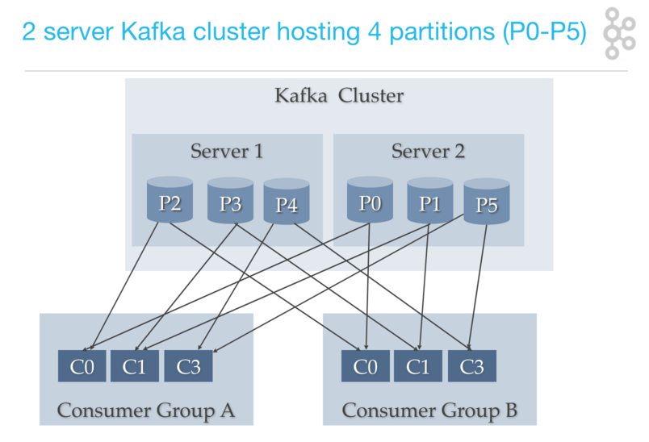
Consumer group
Notes:
The mapping of a consumer to a partition is often called ownership of the partition by the consumer.
In this way, consumers can horizontally scale to consume topics with a large number
of messages
Additionally, if a single consumer fails, the remaining members of the
group will rebalance the partitions being consumed to take over for the missing
member.

Slide 15
Retention and Compaction
Durable storage of messages for some period of time.
Retaining messages:
for some period of time
Until the topic reaches a certain size
Retention policy:
Delete
Compact
Notes:
Individual topics can also be configured with their own retention settings so that messages are stored for only as long as
they are useful. a tracking topic ->several days,
metrics ->hours
Some time only cares about the latest state before the crash, not all the changes that occurred while it was running.
supports such use cases by allowing the retention policy on a topic to be delete,
which deletes events older than retention time, to compact, which only stores the
most recent value for each key in the topic

Slide 16
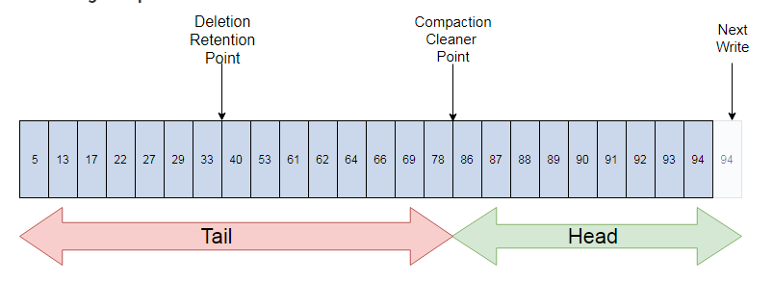
Retention and Compaction
Notes:
If compaction is enabled when Kafka starts (using the awkwardly named configuration), each broker will start a compaction manager thread and a number of compaction threads.
The compaction tasks. Each of these threads chooses the partition with the highest
ratio of dirty messages to total partition size and cleans this partition.

Slide 17
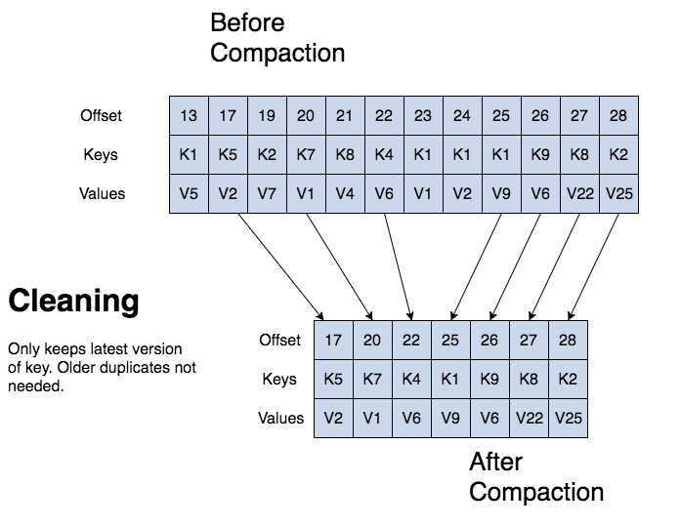
Retention and Compaction
Notes:
Topic config min.compaction.lag.ms gets used to guarantee a minimum period that must pass before a message can be compacted.
A log is broken up into partitions and partitions are divided into segments which contain records which have keys and values.

Slide 18
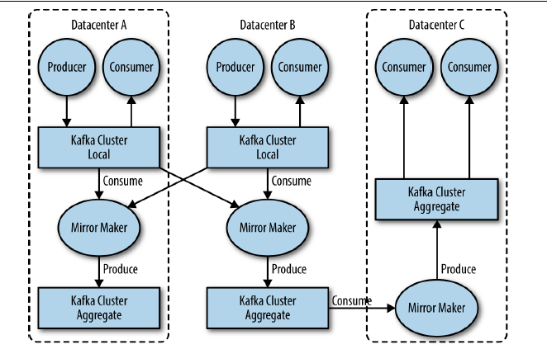
Mirror Maker
A Kafka utility for disaster recovery.
Kafka uses replication for failover.
Mirror Maker replicates a Kafka cluster.
Notes:
When working with multiple datacenters in particular, it is often required that messages
be copied between them. In this way, online applications can have access to user
activity at both sites.

Slide 19
Zookeeper
Kafka uses Zookeeper to
Leadership election of Kafka Broker
Manage service discovery
Storing metadata for the brokers
Receive changes in cluster(node joined, node died, topic added,…)
…

Slide 20
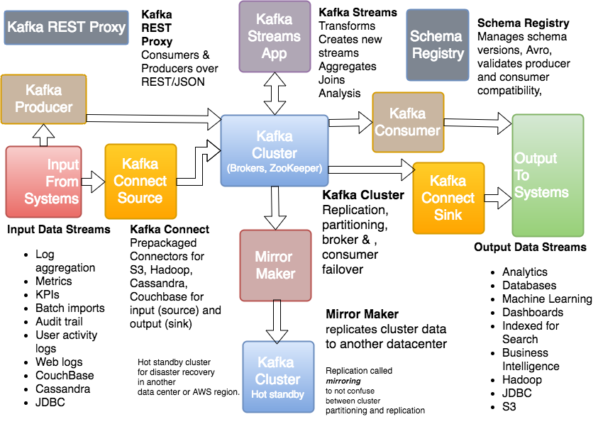
Kafka Ecosystem

Slide 21
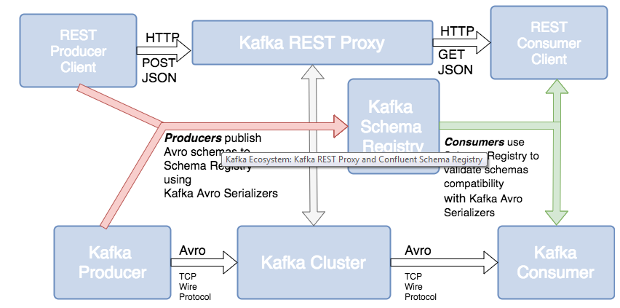
Kafka Ecosystem

Slide 22
Agenda
History
Introduction
Use Cases
Kafka Internal
Kafka streams
Summary

Slide 23
Use cases
Activity tracking
Messaging
Metrics and logging
Commit log
Stream processing
Notes:
*The original use case for Kafka, as it was designed at LinkedIn, is that of user activity tracking.
*Kafka is also used for messaging, where applications need to send notifications (such
as emails) to users.(Applying a user’s preferences for how they want to receive messages)
*Another added benefit of Kafka is that when the destination system needs to
change (e.g., it’s time to update the log storage system), there is no need to alter the
frontend applications or the means of aggregation.
* Starting in 0.10.0.0, a light-weight but powerful stream processing library called Kafka Streams is available in Apache Kafka to perform such data processing as described above. Apart from Kafka Streams, alternative open source stream processing tools include Apache Storm and Apache Samza.

Slide 24
Agenda
History
Introduction
Use Cases
Kafka Internal
Kafka streams
Summary

Slide 25
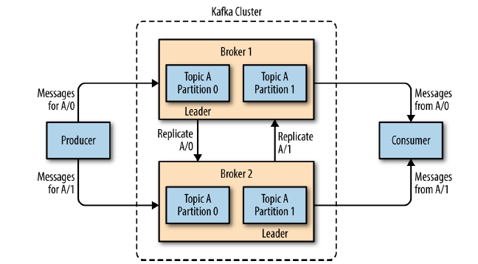
Broker
A single Kafka server is called a broker.
Receives messages from producers
Assigns offsets to them
Commits to storage on disk
Services consumers
Designed to operate as part of a cluster.
Notes:
Depending on the specific hardware and its performance characteristics single broker can easily handle thousands of partitions and millions of messages per second.

Slide 26
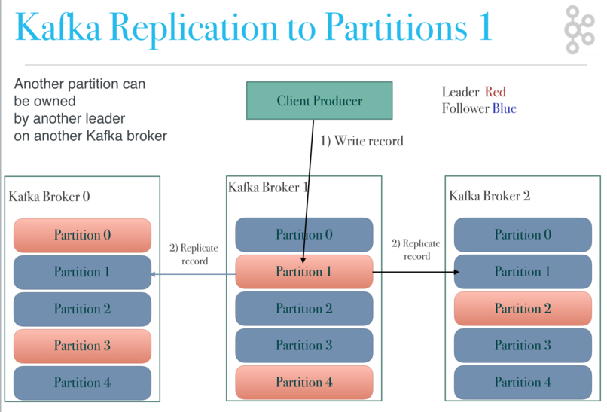
Leader Broker
A partition may be assigned to multiple brokers.
A partition is owned by a single broker (leader of the partition).
Notes:
This provides redundancy of messages in the partition, such that another broker can take over leadership if there is
a broker failure.
However, all consumers and producers operating on that partition must connect to the leader.
A key feature of Apache Kafka is that of retention, which is the durable storage of messages for some period of time
Preferred leader
Find leader by meta data, ISR for take leader ship, even message maybe lost from producer to consumer! But don’t repeat same offset to consumer, log compact

Slide 27
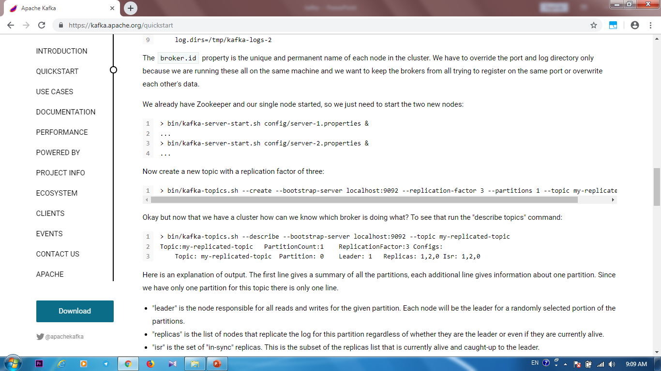

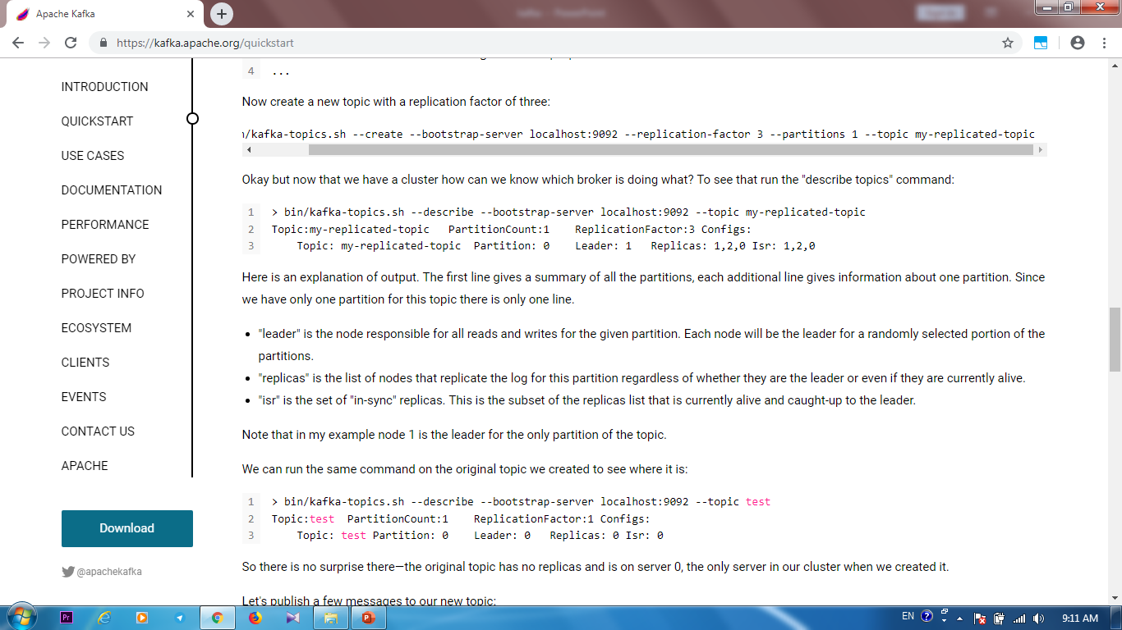

Slide 28
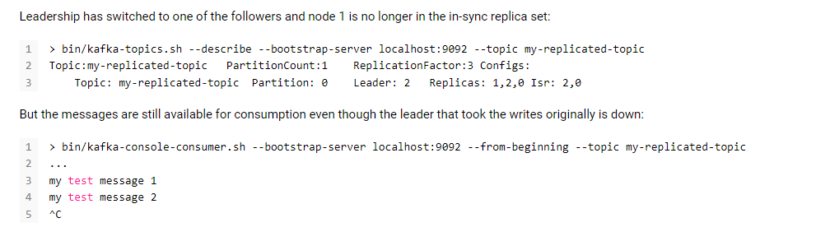

Slide 29
Controller Broker
The controller is a brokers that is responsible for electing partition.
The first broker that starts in the cluster becomes the controller
Notes:
The brokers create a Zookeeper watch on the controller
The first node to create the new controller in Zoo keeper is the new controller, while the other nodes will receive a “node already exists”
exception and re-create the watch on the new controller node.
it receives a new, higher controller epoch number through a Zookeeper conditional increment operation.
When the controller notices that a broker left the cluster (by watching the relevant
Zookeeper path), it knows that all the partitions that had a leader on that broker will
need a new leader.
When the controller notices that a broker joined the cluster, it uses the broker ID to
check if there are replicas that exist on this broker. If there are, the controller notifies
both new and existing brokers of the change, and the replicas on the new broker start
replicating messages from the existing leaders

Slide 30
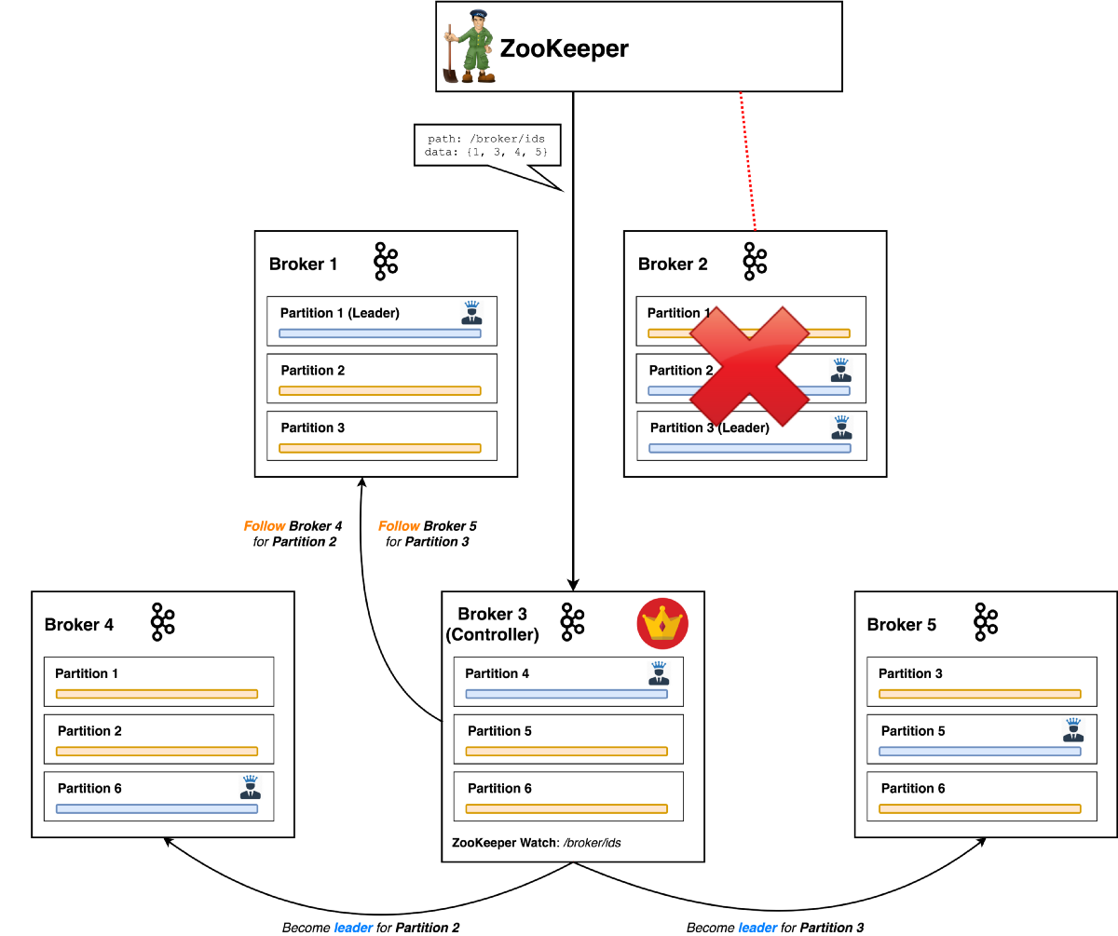
Notes:
The brokers create a Zookeeper watch on the controller
The first node to create the new controller in Zoo keeper is the new controller, while the other nodes will receive a “node already exists”
exception and re-create the watch on the new controller node.
it receives a new, higher controller epoch number through a Zookeeper conditional increment operation.
When the controller notices that a broker left the cluster (by watching the relevant
Zookeeper path), it knows that all the partitions that had a leader on that broker will
need a new leader.
When the controller notices that a broker joined the cluster, it uses the broker ID to
check if there are replicas that exist on this broker. If there are, the controller notifies
both new and existing brokers of the change, and the replicas on the new broker start
replicating messages from the existing leaders

Slide 31
Agenda
History
Introduction
Use Cases
Kafka Internal
Kafka streams
Summary

Slide 32
Kafka Streams
Client library for processing data stored in Kafka
Building on the Kafka producer and consumer libraries
windowing support
Transparently load balancing
No external dependencies
Support fault-tolerant local state
Supports exactly-once processing
Notes:
Note the key difference between Kafka Streams end-to-end exactly-once guarantee with other stream processing frameworks' claimed guarantees is that Kafka Streams tightly integrates with the underlying Kafka storage system and ensure that commits on the input topic offsets, updates on the state stores, and writes to the output topics w
ill be completed atomically instead of treating Kafka as an external system that may have side-effects.
Stream processing is a programming paradigm—just like request response
and batch processing. Request response -> stream processing -> batch processing

Slide 33
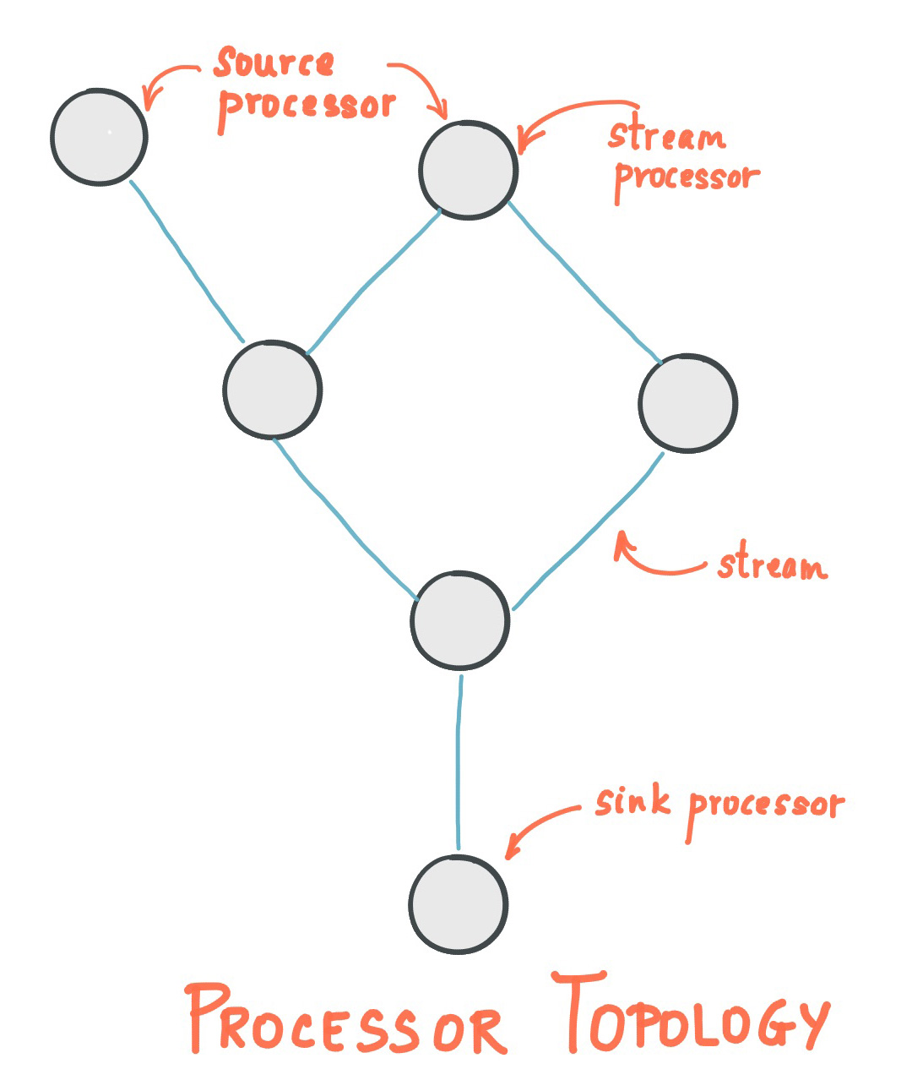
Key concepts
A stream is an unbounded, ordered, re-playable, and fault-tolerant sequence of immutable data records.
Stream processing application: program that use Kafka Streams library
Notes:
Out of order handling If users want to handle such out-of-order data, generally they need to allow their applications to wait for longer time while bookkeeping their states during the wait time, i.e. making trade-off decisions between latency, cost, and correctness
Processor topology: graph of stream processors (nodes) that are connected by streams (edges)
A stream processor is a node in the processor topology; it represents a processing step to transform data in streams by receiving one input record at a time from its upstream processors in the topology, applying its operation to it, and may subsequently produce one or more output records to its downstream processors.
two ways to define the stream processing topology
the Kafka Streams DSL provides the most common data transformation operations such as map, filter, join and aggregations out of the box;
the lower-level Processor API allows developers define
Kstream and Ktable

Slide 34
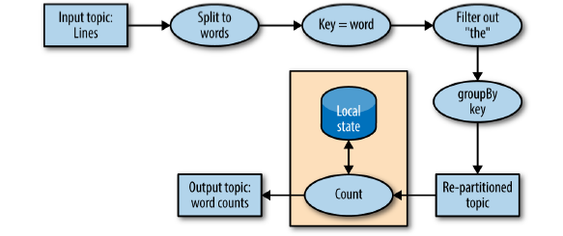

Slide 35
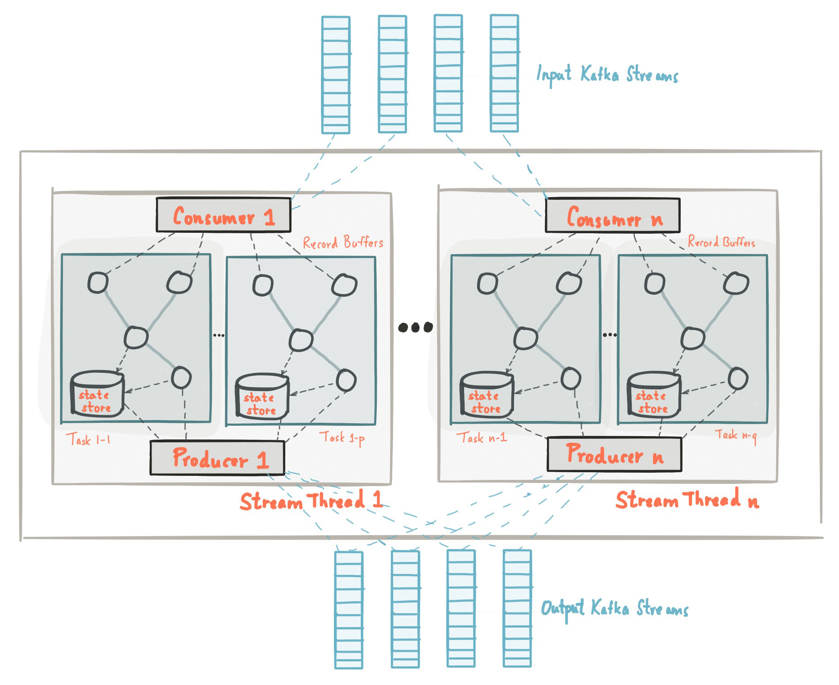
Kafka Streams Architecture
Notes:
An application's processor topology is scaled by breaking it into multiple tasks
, Kafka Streams creates a fixed number of tasks based on the input stream partitions for the application, with each task assigned a list of partitions from the input streams (i.e., Kafka topics)
assignment of partitions to tasks never changes so that each task is a fixed unit of parallelism of the application.
Threading Model
Local State Stores
Every stream task in a Kafka Streams application may embed one or more local state stores that can be accessed via APIs to store and query data required for processing.
fault-tolerance and automatic recovery for such local state stores.
Kafka Streams builds on fault-tolerance capabilities integrated natively within Kafka.
changelog topics are partitioned as well so that each local state store instance,
. Log compaction is enabled on the changelog topics so that old data can be purged safely to prevent the topics from growing indefinitely.

Slide 36
Agenda
History
Introduction
Use Cases
Kafka Internal
Kafka streams
Summary

Slide 37
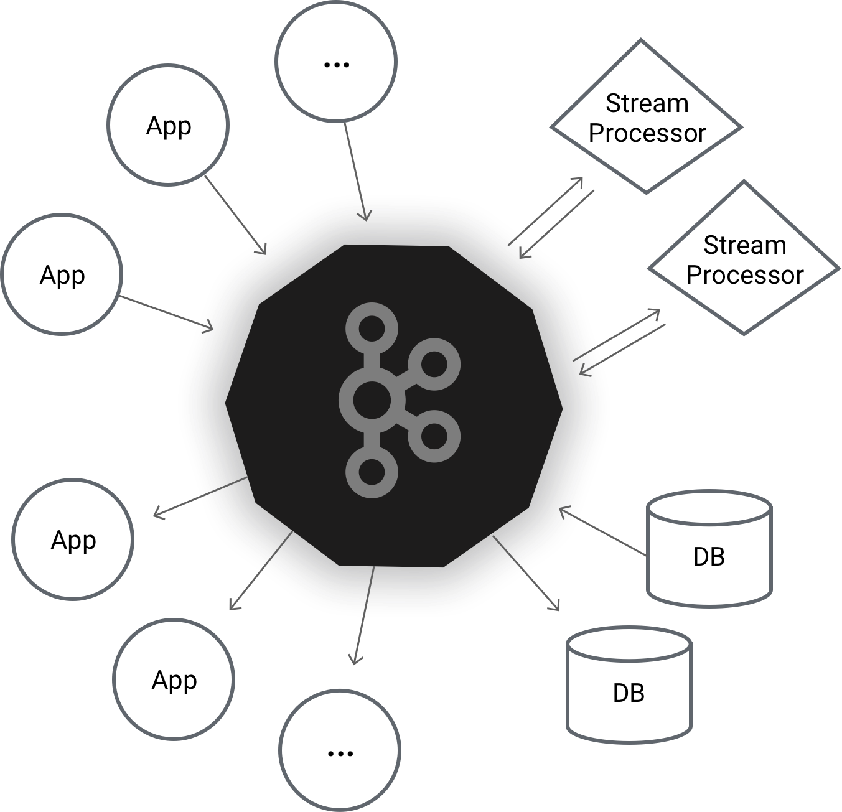
Summary
Apache Kafka is a distributed streaming platform.
Horizontally scalable
Fault-tolerant
Fast
Four core APIs

Slide 38
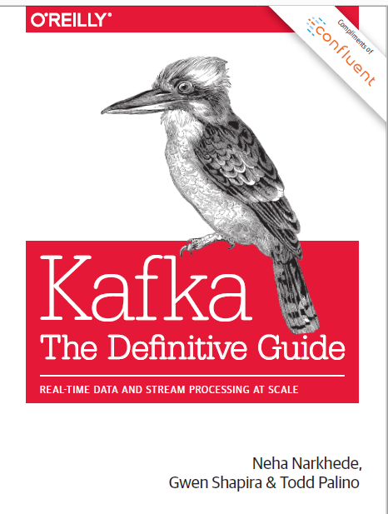
Resources
N. Narkhede, G. Shapira, T. Palino, Kafka: The Definitive Guide, O’Reilly Media, 7 July 2017.

Slide 39
Resources
“Apache Kafka”, URL: https://kafka.apache.org/intro, Access Date: 6 Jun 2019.
“Apache Kafka Documentation”, URL: https://kafka.apache.org/documentation/, Access Date: 6 Jun 2019.
“Kafka Streams”, URL: https://kafka.apache.org/22/documentation/streams/, Access Date: 6 Jun 2019.
“Apache Kafka’s Distributed System Firefighter — The Controller Broker”, Stanislav Kozlovski, URLhttps://hackernoon.com/apache-kafkas-distributed-system-firefighter-the-controller-broker-1afca1eae302, Access Date: 6 Jun 2019.
“What is Apache Kafka”, URL: http://cloudurable.com/blog/what-is-kafka/index.html, Access Date: 6 Jun 2019.
“Kafka Architecture”, URL: http://cloudurable.com/blog/kafka-architecture/index.html, Access Date: 6 Jun 2019.
“Kafka Topic Architecture”, URL: http://cloudurable.com/blog/kafka-architecture-topics/index.html, Access Date: 6 Jun 2019.
“Kafka Architecture: Low-Level Design”, URL: http://cloudurable.com/blog/kafka-architecture-low-level/index.html, Access Date: 6 Jun 2019.
“The Kafka Ecosystem - Kafka Core, Kafka Streams, Kafka Connect, Kafka REST Proxy, and the Schema Registry”, URL: http://cloudurable.com/blog/kafka-ecosystem/index.html, Access Date: 6 Jun 2019.

Slide 40
Appendix

Slide 41
Transactions in Apache Kafka
Transactions are designed in Kafka primarily for applications which exhibit a “read-process-write” pattern where the reads and writes are from and to asynchronous data streams such as Kafka topics.(stream processing applications)
Stream processing application could lose exactly once processing semantics
Transaction APIs are designed in Kafka to solve exactly once processing problem.
The transaction feature is primarily a server-side and protocol level feature which is available for use by any client library that supports it

Slide 42
Transactional Semantics in Kafka
Atomic multi-partition writes
Enable atomic writes to multiple Kafka topics and partitions.
All of the messages included in the transaction will be successfully written or none of them will be.
Zombie fencing
Solve the problem of zombie instances
Each transactional producer is assigned a unique identifier(transactional.id)
Notes:
The API requires that the first operation of a transactional producer should be to explicitly register its transactional.id with the Kafka cluster. When it does so, the Kafka broker checks for open transactions with the given transactional.id and completes them. It also increments an epoch associated with the transactional.id. The epoch is an internal piece of metadata stored for every transactional.id.
Once the epoch is bumped, any producers with same transactional.id and an older epoch are considered zombies and are fenced off, i.e.. future transactional writes from those producers are rejected.

Slide 43
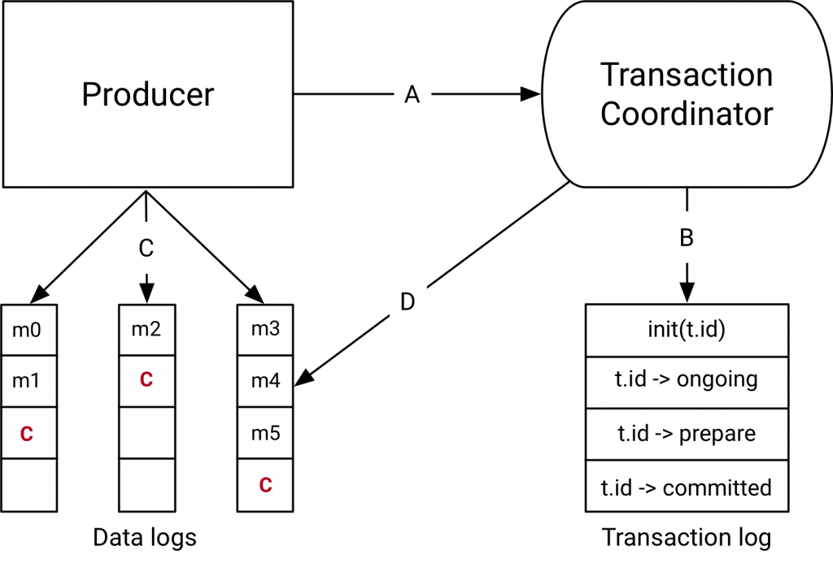
How Transactions Work
Notes:
The Transaction Coordinator and Transaction Log
The components introduced with the transactions API in Kafka 0.11.0 are the Transaction Coordinator and the Transaction Log on the right hand side of the diagram above.
The transaction coordinator is a module running inside every Kafka broker.
The transaction log is an
internal Kafka topic. Each coordinator owns some subset of the partitions in the transaction log
A: the producer and transaction coordinator interaction
When executing transactions, the producer makes requests to the transaction coordinator at the following points:
The initTransactions API registers a transactional.id with the coordinator. At this point, the coordinator closes any pending transactions with that transactional.id and bumps the epoch to fence out zombies. This happens only once per producer session.
When the producer is about to send data to a partition for the first time in a transaction, the partition is registered with the coordinator first.
When the application calls commitTransaction or abortTransaction, a request is sent to the coordinator to begin the two phase commit protocol.
B: the coordinator and transaction log interaction
As the transaction progresses, the producer sends the requests above to update the state of the transaction on the coordinator. The transaction coordinator keeps the state of each transaction it owns in memory, and also writes that state to the transaction log (which is replicated three ways and hence is durable).
The transaction coordinator is the only component to read and write from the transaction log. If a given broker fails, a new coordinator is elected as the leader for the transaction log partitions the dead broker owned, and it reads the messages from the incoming partitions to rebuild its in-memory state for the transactions in those partitions.
C: the producer writing data to target topic-partitions
After registering new partitions in a transaction with the coordinator, the producer sends data to the actual partitions as normal. This is exactly the same producer.send flow, but with some extra validation to ensure that the producer isn’t fenced.
D: the coordinator to topic-partition interaction
After the producer initiates a commit (or an abort), the coordinator begins the two phase commit protocol.
In the first phase, the coordinator updates its internal state to “prepare_commit” and updates this state in the transaction log. Once this is done the transaction is guaranteed to be committed no matter what.
The coordinator then begins phase 2, where it writes transaction commit markers to the topic-partitions which are part of the transaction.
These transaction markers are not exposed to applications, but are used by consumers in read_committed mode to filter out messages from aborted transactions and to not return messages which are part of open transactions (i.e., those which are in the log but don’t have a transaction marker associated with them).
Once the markers are written, the transaction coordinator marks the transaction as “complete” and the producer can start the next transaction.

Slide 44
How Transactions Work
Data flow
A: the producer and transaction coordinator interaction
B: the coordinator and transaction log interaction
C: the producer writing data to target topic-partitions
D: the coordinator to topic-partition interaction
Notes:
A: the producer and transaction coordinator interaction
When executing transactions, the producer makes requests to the transaction coordinator at the following points:
The initTransactions API registers a transactional.id with the coordinator. At this point, the coordinator closes any pending transactions with that transactional.id and bumps the epoch to fence out zombies. This happens only once per producer session.
When the producer is about to send data to a partition for the first time in a transaction, the partition is registered with the coordinator first.
When the application calls commitTransaction or abortTransaction, a request is sent to the coordinator to begin the two phase commit protocol.
B: the coordinator and transaction log interaction
As the transaction progresses, the producer sends the requests above to update the state of the transaction on the coordinator. The transaction coordinator keeps the state of each transaction it owns in memory, and also writes that state to the transaction log (which is replicated three ways and hence is durable).
The transaction coordinator is the only component to read and write from the transaction log. If a given broker fails, a new coordinator is elected as the leader for the transaction log partitions the dead broker owned, and it reads the messages from the incoming partitions to rebuild its in-memory state for the transactions in those partitions.
C: the producer writing data to target topic-partitions
After registering new partitions in a transaction with the coordinator, the producer sends data to the actual partitions as normal. This is exactly the same producer.send flow, but with some extra validation to ensure that the producer isn’t fenced.
D: the coordinator to topic-partition interaction
After the producer initiates a commit (or an abort), the coordinator begins the two phase commit protocol.
In the first phase, the coordinator updates its internal state to “prepare_commit” and updates this state in the transaction log. Once this is done the transaction is guaranteed to be committed no matter what.
The coordinator then begins phase 2, where it writes transaction commit markers to the topic-partitions which are part of the transaction.
These transaction markers are not exposed to applications, but are used by consumers in read_committed mode to filter out messages from aborted transactions and to not return messages which are part of open transactions (i.e., those which are in the log but don’t have a transaction marker associated with them).
Once the markers are written, the transaction coordinator marks the transaction as “complete” and the producer can start the next transaction.

Slide 45
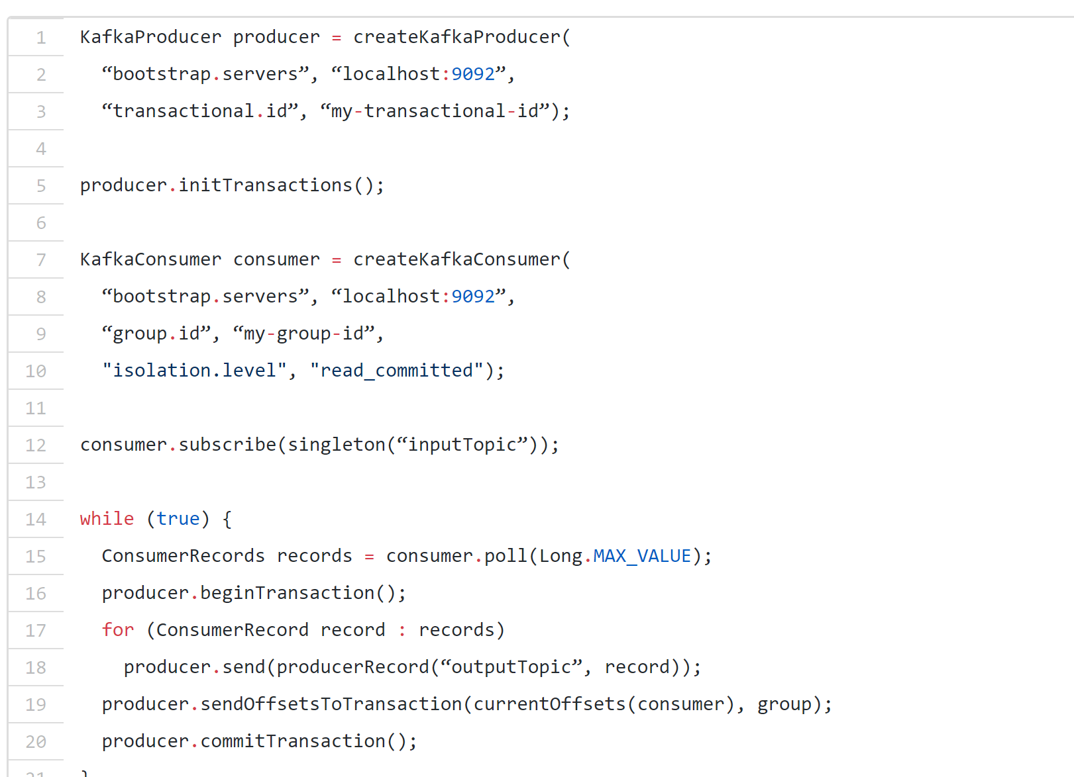

Slide 46
Kafka in banks
Real-time Financial Alerts at Rabobank with Apache Kafka’s Streams API
The case: Rabo Alerts
Rabo Alerts is a service that allows Rabobank customers to be alerted whenever interesting financial events occur.
The Evolution of Kafka at ING Bank
It all started within ING when a solution was needed to improve our fraud detection system for online banking.
Notes:
A simple example of an event is when a certain amount was debited from or credited to your account, but more complex events also exist.

Slide 47
Does Apache Kafka do ACID transactions?
The biggest difference between message queuing systems such as IBM MQ and event streaming systems such as Apache Kafka is the idea of a stream history.
There’s another major difference too and that’s to do with transactions.
Kafka does have a feature called exactly-once semantics but it offers a much weaker guarantee than proper transactions. It looks like transactions at the API level, but if you look inside, it’s not the same.
Transactional systems implement the four ACID properties: Atomicity, Consistency, Isolation, and Durability.
Notes:
Essentially, in an event streaming system, the historical events on an event stream are not immediately removed when they’re consumed. They stay around.

Slide 48
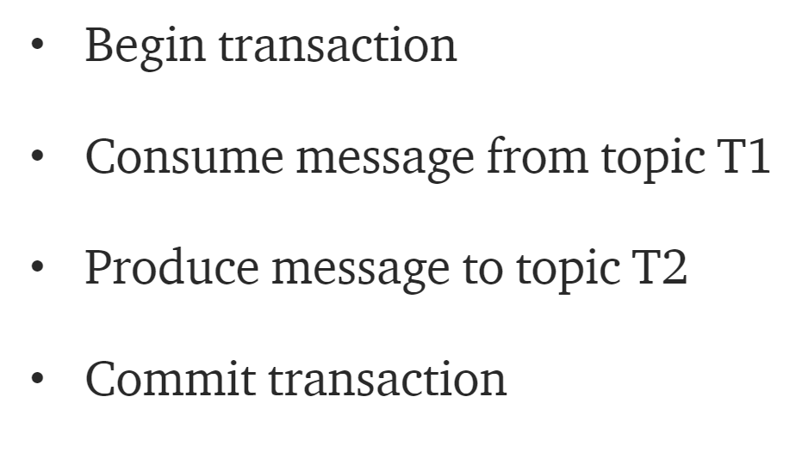
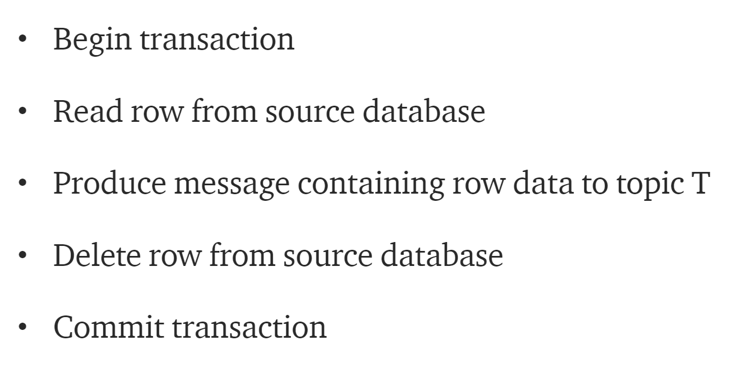
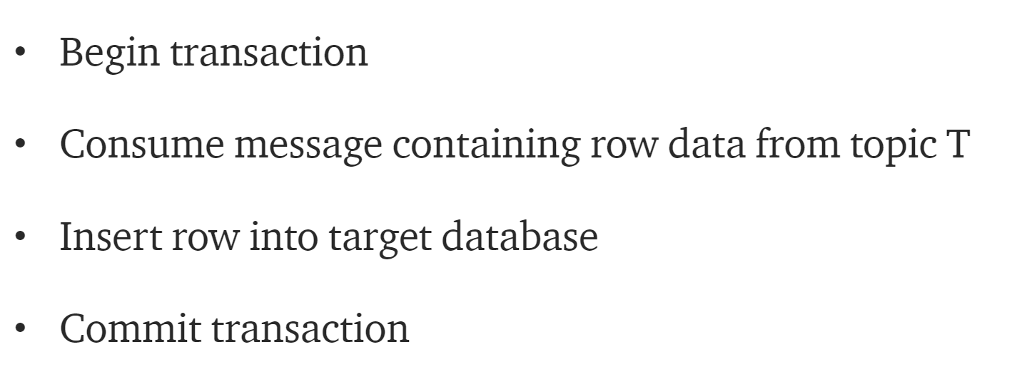
Messaging and transactions in practice
Most basic example looks like this
A more complicated example
Notes:
This is an example of a distributed transaction and it uses a technique called two-phase commit.
IBM MQ can achieve both of these example with ease.
Apache Kafka can only do the first easily.
If you’re a total expert, you could also achieve the second with some extremely carefully written application code ensuring in all cases and failure modes that there is no data loss and no duplication.
In Apache Kafka, the exactly-once-semantics APIs are a powerful tool for stream processing applications, but the transactional guarantees are relatively weak.
If a transaction uses two different partitions, the leader for each partition is responsible for recording the operations into its own log. There’s also an internal topic used to record the overall transaction state. So, the durable state of the transaction is spread across multiple logs and potentially multiple servers

Slide 49
So, does Apache Kafka do ACID transactions? No.
Can you get a similar effect? If you design your applications in the right way, yes.
Notes:
If you examine the design of transaction commit in Kafka, it looks a little like a two-phase commit with a prepare-to-commit control message on the transaction state topic, then commit markers on real topics, and finally a commit control message on the transaction state topic. It’s clever but it’s more fragile.
Then you factor in the way that Kafka writes to its log asynchronously and you can see that what Kafka considers to be a committed transaction is not really atomic at all.

Slide 50
Kafka as a message broker
When a message broker is needed?
If you want to control data feeds. For example, the number of registrations in any system.
When the task is to put data to several applications and avoid direct usage of their API.
The necessity to complete processes in a defined order like a transactional system.
Message brokers can do 4 important things
Divide the publisher and consumer
Store the messages
Route messages
Check and organize messages

Slide 51
There are 2 main patterns of messaging:
Queuing
Publish-subscribe
The advantage of the first pattern is the opportunity to easily scale the processing.
The second model provides the possibility to broadcast data to multiple consumer groups.
Apache Kafka combines these ways, getting benefits of both of them.

Slide 52
Combining the functions of messaging, storage, and processing, Kafka isn’t a common message broker.
It’s a powerful event streaming platform capable of handling trillions of messages a day.
Is useful both for storing and processing historical data from the past and for real-time work.
You can use it for creating streaming applications, as well as for streaming data pipelines.

Slide 53
Resources
“Exactly once Semantics are Possible: Here’s How Kafka Does it”, URL:https://www.confluent.io/blog/exactly-once-semantics-are-possible-heres-how-apache-kafka-does-it/, Access Date: 14 Jun 2019.
“Transactions in Apache Kafka”, URL:https://www.confluent.io/blog/transactions-apache-kafka/, Access Date: 14 Jun 2019.
“Transactional Messaging in Kafka”, URL:https://cwiki.apache.org/confluence/display/KAFKA/Transactional+Messaging+in+Kafka, Access Date: 14 Jun 2019.
“Does Apache Kafka do ACID transactions?”, URL: https://medium.com/@andrew_schofield/does-apache-kafka-do-acid-transactions-647b207f3d0e, Access Date: 14 Jun 2019.
“Real-time Financial Alerts at Rabobank with Apache Kafka’s Streams API”, URL: https://www.confluent.io/blog/real-time-financial-alerts-rabobank-apache-kafkas-streams-api/, Access Date: 14 Jun 2019.
“The Evolution of Kafka at ING Bank”, URL: https://www.confluent.io/kafka-summit-london18/the-evolution-of-kafka-at-ing-bank, Access Date: 14 Jun 2019.
“Introduction to Message Brokers: Part 1: Apache Kafka vs RabbitMQ”, URL: https://hackernoon.com/introduction-to-message-brokers-part-1-apache-kafka-vs-rabbitmq-8fd67bf68566, Access Date: 14 Jun 2019.

